Slide 1
10 Simple Rules for Conducting a Data Inventory Sara Gonzales, MLIS Data Librarian
Galter Health Sciences Library & Learning Center
Northwestern University Feinberg School of Medicine

Slide 2

By the end of this workshop, you will have a roadmap for:
Planning a data inventory
Collecting data about your data
Cataloging your data
Making data inventorying a continuing effort
Next steps after inventorying your data

Slide 3
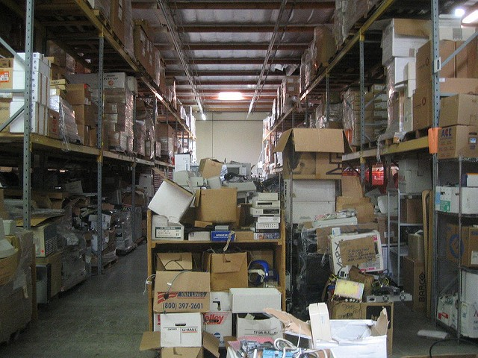
How the creation of data files gets out of control
A large volume of data files are generated in multiple types and from multiple sources
Storing files in multiple settings: Box, Google Drive, University servers
Lack of a clear folder structure on shared drives, either server or cloud-based
Lack of file-naming conventions, leading to individuals creating their own filenames
Lack of a “data steward” role – a staff member whose duties include creating and enforcing file-naming conventions, folder structures, backups and security for data, etc.
Image: https://www.flickr.com/photos/roland/1413399/ (Public Domain)

Slide 4

Solution: the Data Inventory
“A data inventory is a list of datasets with metadata that describes their contents, source, licensing, and other useful information.”
(Beale et. al., How to Create a Data Inventory, https://doi.org/10.21955/gatesopenres.1114885.1)
Image by Freepik: www.freepik.com/free-photos-vectors/background
Notes:
A data inventory can take any form you like, from a document to a spreadsheet to a database. The important things are that:
It lists every data asset you have for a project, no matter how small
It lists how the data were created and by whom
It lists any sources of changes to the data
It contains resources and advice for those who might come along later to use the data, even if this is you or someone in your project or team.

Slide 5
Rule 1: Define the scope of your data inventory
What is the purpose of your inventory?
General data management
Improve data governance – assign roles and duties in data management
Identify new partnership, publication, and dissemination opportunities
Is more granular data-cleaning needed? The inventory can help answer…
Preparing for data sharing to meet funder requirements
Will only subsets of the data be shared? Keep requirements in mind while inventorying
(Adapted from Beale et. al., How to Create a Data Inventory, https://doi.org/10.21955/gatesopenres.1114885.1)
Notes:
Knowing the purpose of your inventory helps you define its scope, and to decide what the end product will be. Along the way, this will help you decide what metadata to use to describe your data.

Slide 6
Rule 2: Define how the project will be sustained
Who is responsible for the data inventory?
Is there a Data Steward, either for this project or on a permanent basis?
Can the creation and maintenance of the inventory be added to existing workflows?
Where will the end product of the inventory be hosted and accessed, and by whom?
Who will update the inventory?
(Adapted from Beale et. al., How to Create a Data Inventory, https://doi.org/10.21955/gatesopenres.1114885.1)
Notes:
Do you envision this inventory as a one-time exercise, or do you plan to maintain it as an ongoing effort? If so, how can you ensure that it will be sustained, and how can you allot for the work to sustain it within your existing workflows?

Slide 7

Appoint a Data Steward
Accountable for the integrity and quality of project data
Create and uphold data standards and operating procedures
Naming conventions, folder structures
Develop data documentation
Ensure data security
Help ensure compliance (with funder requirements, sharing stipulations, etc.)
Be an advocate for data management on the team
Oversee and periodically re-launch inventories
Adapted from usgs.gov: Data Management: Stewardship: https://www.usgs.gov/products/data-and-tools/data-management/stewardship

Slide 8
Rule 3: Define the data to be inventoried
What does the word data encompass?
Datasets
Original raw data files
Paper-based assets
Data produced both out-of-house and within
Decide what level of detail you need
Will you inventory down to the level of individual datasets, or groups of them?
It’s easier to generalize from the granular level; more difficult to go back later for more detail
(Adapted from Beale et. al., How to Create a Data Inventory, https://doi.org/10.21955/gatesopenres.1114885.1)
Notes:
Before inventorying anything, make sure the entire team agrees on what is meant by the terms data and datasets. Assets are less likely to be left out if everyone agrees on what constitutes data.
Decide at what level of detail to make notes on or catalog your data. If you envision needing detailed notes at some point in the future, then it is likely that every file will need to be reviewed.
Make sure that all datasets are identified for the inventory, no matter their format or location.

Slide 9
Rule 4: Think from the end: how will your data be described?
Identification
File names
File types
File descriptions
Subjects/Keywords
Data owners
Data contributors
Data sources
Tools that generated or processed data
Granularity of data
Sensitivity level of data
Location
Study sites
Data collection sites
Storage solutions
Backups and versioning
Sources of secondary data
Repositories
Partner sites’ storage
Journals hosting shared data
Funder databases hosting shared data
Time
Data collection dates/times
Timing of changes made to data and frequency of changes
Data processing timelines
Frequency of data access
Reporting schedules
Embargos for data sharing
Team members’ tenures
Long-term retention solutions
Notes:
Each project is different, and each grouping of data may have different things about it that you would like to record. The list here is only a set of suggestions for things to note about data as you’re inventorying. Remember to include information about the data sources, including the technology, systems and code that helped to create the data.

Slide 10

Creating a cataloging “sheet”
A brief sample data catalog record
Attribute | Description
Dataset Name | Unique name or identifier
Dataset Description | Describe the data asset
Dataset Creator | List creators’ names in Last Name, First Name order
Dataset Owner | List owner(s) of the dataset
Subject/Keywords | Free-text or controlled vocabulary dataset descriptors
Date of Creation | Date on which the data file was created
Time of Creation | Time at which data files were created
Data catalog table adapted from: Beale et. al., How to Create a Data Inventory, https://doi.org/10.21955/gatesopenres.1114885.1
Notes:
Before you begin to collect data about your data through your inventory, think about where this metadata will be recorded. A catalog of some kind, which can be accessed by all the stakeholders, referenced, and updated as needed, will be the most useful. This catalog can take the form of an Excel spreadsheet (and can be based on the data inventory templates – see next slide), or a database created by project team members. The format is less important than collecting and cataloging the data in a consistent manner. Create variable names for all the data points you are collecting, and define them in a data dictionary style so they are easily understandable by the project team. Knowing what you’d like your “data catalog” to look like at the end of the process helps to inform the development of your inventory’s data collection tool.

Slide 11

14.5 million metadata records
Over 50 published use cases
9 academic health science library partners
Your catalog can be mapped to common dataset schema
DataCite Metadata Schema 4.2
Data Catalog Vocabulary (DCAT) Ontology
Stats and references:
DataCite: stats.datacite.org/
DCAT Ontology: w3.org/TR/dcat-ucr/#UseCases
Data Catalog Collaboration Project: datacatalogcollaborationproject.org/dccp-resources
Data Catalog Collaboration Project Metadata Schema
Notes:
By inventorying your data on a regular basis, you are essentially cataloging it, or preparing it to be cataloged in a data- or institutional repository. You can reference these sources for dataset schema, or look at the metadata available in your local repository, DigitalHub (digitalhub.northwestern.edu). Even the popular Web markup language schema.org has a dataset extension (schema.org/dataset). This growth of dataset schema in recent years is due to increased demands from funders and publishers for access to publicly deposited data.

Slide 12
Rule 5: Create an inventory tool
Data Audit Forms
DataSF’s Data Inventory Template from the City and County of San Francisco
State of South Carolina Data Inventory Tool
Create your own inventory tool. Things to consider:
Dataset name/file names
Dataset description and type
Subjects and keywords
Data owners/license
Tools that generated the data
Changes to data
Data quality/granularity
Spatial and temporal coverage

Slide 13
Rule 6: Identify everyone who works with data on the project and enlist their help
Investigator
Graduate Students
Informaticist
Biostatistician
Clinical Research Coordinator
Lab Manager
Project Managers
Notes:
If you have a data auditing form in place, you can delegate some of the data collection work to those in your lab or on your project who currently serve as the ‘data owners.’ This could be a wide array of people, of which this diagram likely barely scratches the surface. Project participants can help with the data inventory effort through interviews, or by filling out questionnaires on their data and file usage.

Slide 14
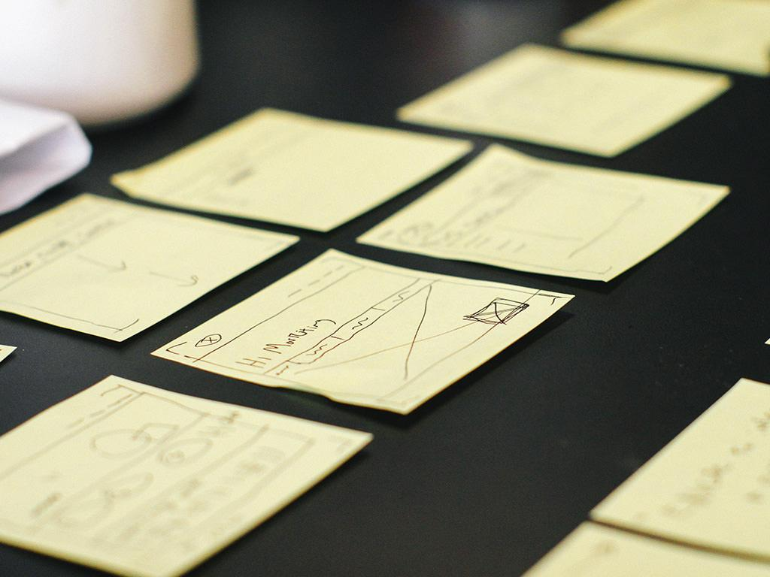
Rule 7: Managing the project and collecting the data
Notes:
Manage the data inventory project as closely as you would any other. Assign tasks, delegate duties, clearly define the deliverables, make a template for weekly progress reports. Identify blockers and deal with them in a timely manner so the overall project schedule is not affected.
For an ongoing effort, managing regular data inventories can be part of the job description/list of duties of your data steward. If the data steward role is shared among a few different team members, ask them to take turns managing individual inventory projects. As each person takes their turn at being project manager, they will come to appreciate the importance of completing inventory work in a timely and thorough manner.

Slide 15

Rule 7: Collect inventory data: interviews with data owners and project managers
Who interacts with data
All the individuals who produce/update/change/manage/store data
Teams responsible for data
Labs & lab managers
People who receive data: research administrators, evaluators
Information to collect in interviews
Basic data descriptors as outlined in cataloging sheet
Uses to which data will be put by both the project team and people outside the team, but data-involved
Notes:
Interviews and questionnaires are a great way to elucidate current practices with data. Interviews can take the form of a free-form discussion during which files and storage systems are pointed out and recorded, or they can be more structured. Questionnaires allow for the collection of highly specific file data. Whichever data collection method you use, make sure you’ve collected all the information included in your inventory form/catalog record format.

Slide 16

Rule 7: Collect inventory data: Send surveys/questionnaires about the data
The same questions you would have asked in interviews can also be sent to data owners via a questionnaire. Include enough guidance to ensure consistency.
Ask for data owner and contributor details
Data collection tools: use standard names along with any shorthand
Encourage respondents to express dates and location names in consistent ways

Slide 17
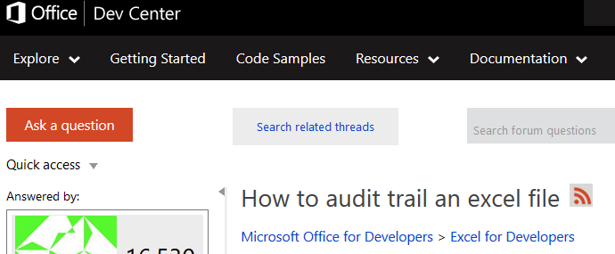
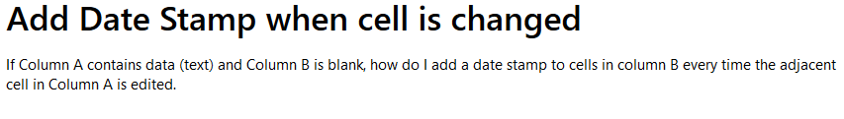
Rule 7: Collect inventory data: Automated inventory processes
Place your screenshot here
Are there automated processes you can build into your data files that show when changes were made, and by whom?
Is there a database for data collection that can leverage permissions, audit trails, and timestamps?
Caveat: keep audit information separate from raw data
Images courtesy of answers.microsoft.com and social.msdn.microsoft.com

Slide 18
The inventory process so far
Plan your inventory
Collect Data about Your Data
Catalog this Data
How do we make an inventory more than a one-time effort?

Slide 19
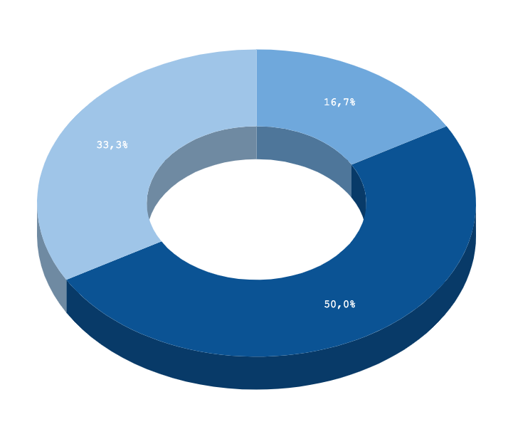
Rule 8: Set a schedule
Catalog the inventory data: October - November
If the entire data inventory process takes roughly half a year, brainstorm with your team about the best interval at which to repeat the process.
How often do significant changes to your team’s data take place? These signposts will help you to schedule the next inventory.
Plan inventory: May-June
Collect data about the data: July - September

Slide 20

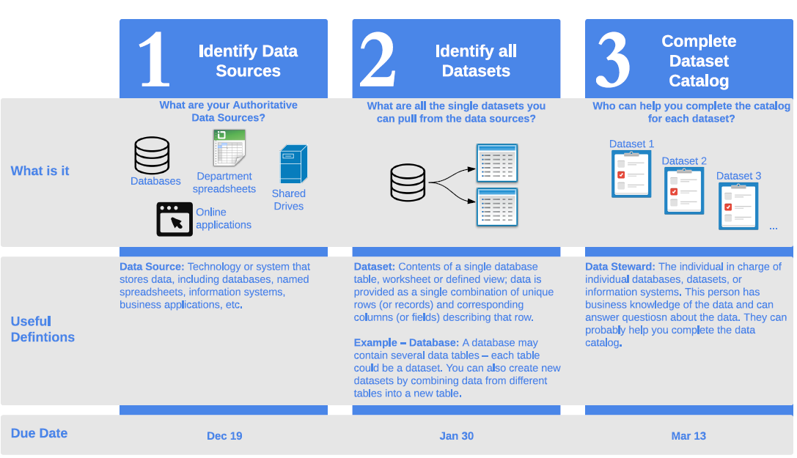
Rule 9: Document inventory procedures
Images: Data San Francisco’s One Page Summary of Data Inventory Process: drive.google.com/uc?export=download&id=0B6av1JsL3xAnU25abC1wSFhXOG8
Freepik: freepik.com
Notes:
Avoid reinventing the wheel by documenting your inventory procedures. You can create a flyer along the lines of this one from Data San Francisco, which can help team members and new inventory participants to understand the inventory process. You can also save your inventory and catalog forms and all other project documentation for future re-use. Write out standard operating procedures, or step-by-step documentation about how to conceive, plan and execute the data inventory. Remember to include allowances for staffing and resources.

Slide 21
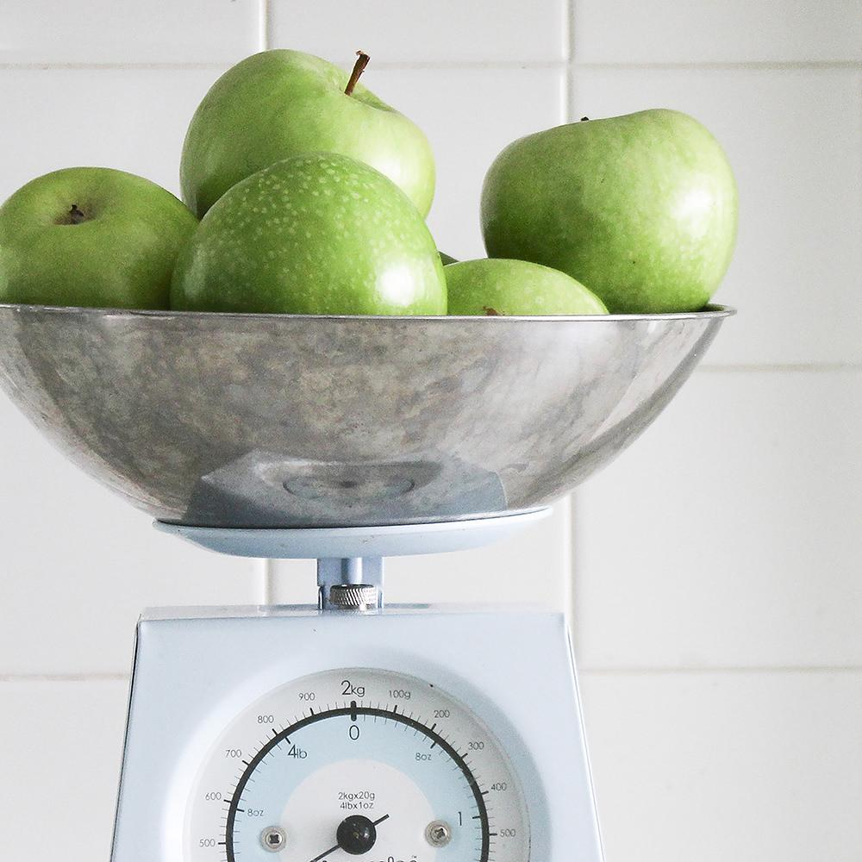
Rule 10: Leverage your inventory for maximum benefit
Research Data Management: use your inventory as a springboard to recommend better RDM practices
Develop policies: for file naming conventions, organizing file directories, storage and backups, quality and integrity checks
Implement the policies with practical guidelines
Establish a training program appropriate to staff needs
Planning: Use your inventory as an opportunity to budget for additional data curation and re-use work

Slide 22

DigitalHub: a local resource
Place your screenshot here
If data has been inventoried, cataloged, de-identified, and is ready to be shared, consider depositing it in DigitalHub.
Benefits:
Allow others to cite your deposited data
Track versions
Share data with collaborators
Make collections
‘Private’ setting for data not ready to be shared

Slide 23
Thanks!
Any questions?
You can find me at:
@saragon02 (GitHub)
sara.gonzales2@northwestern.edu

Slide 24

Credits
Beale, Tim, et. al. How to Create a Data Inventory. Open Data Institute, 2018. doi.org/10.21955/gatesopenres.1114885.1
San Francisco Open Data: DataSF. datasf.org/opendata/
State of South Carolina Data Inventory Tool
USGS.gov: Data Management, Stewardship: usgs.gov/products/data-and-tools/data-management/stewardship
Presentation template by SlidesCarnival licensed under a Creative Commons Attribution 4.0 International License (CC BY 4.0)
Photographs by Death to the Stock Photo (license) unless otherwise credited

